Slide 1
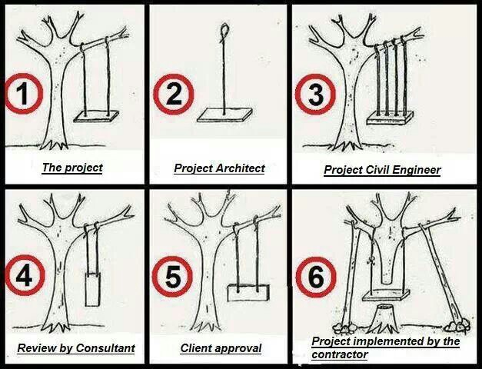

Slide 2
What is the distinction between - between architecting and engineering?
Engineering deals almost entirely with measurables using analytic tools derived from mathematics and the hard sciences; that is, engineering is a deductive process.
Architecting deals largely with unmeasurables using nonquantitative tools and guidelines based on practical lessons learned; that is, architecting is an inductive process

Slide 3
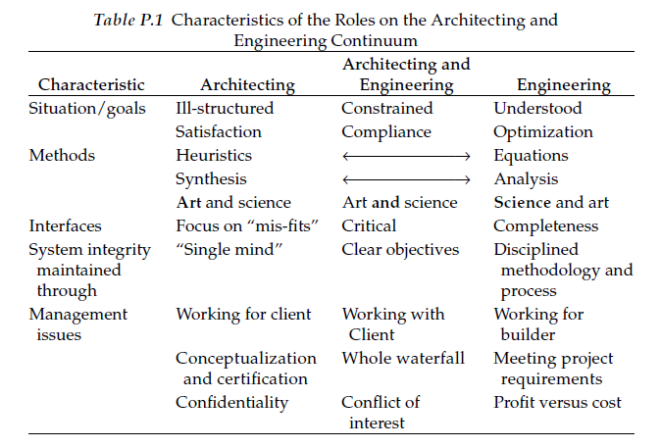
The art of systems architecture – Mark Maier

Slide 4
Four Architecting Methodologies
Normative (solution based)
Examples: building codes and communications standards or protocol standards
Rational (method based)
Examples: systems analysis and engineering
Participative (stakeholder based)
Examples: concurrent engineering and brainstorming
Heuristic (lessons learned)
Examples: Simplify. Simplify. Simplify. and SCOPE!

Slide 5
Selected Artifacts Created during the Architecture Process
Define a consistent logical architecture—capture the logical sequencing and interaction of system functions or logical elements.
Partition system requirements and allocate them to system elements and subsystems with associated performance requirements—evaluate off-the-shelf solutions that already exist.
Evaluate alternative design solutions using trade studies.
Identify interfaces and interactions between system elements (including human elements of the system) and with external and enabling systems.
Define the system integration strategy and plan (to include human system integration).
Document and maintain the architectural design and relevant decisions made to reach agreement on the baseline design.
Establish and maintain the traceability between requirements and system elements.
Define verification and validation criteria for the system elements.

Slide 6
Simplified architecture/definition
Entity Component System consists of three primary items:
Components
A component simply holds a piece of data and does not contain any game logic. Your typical component will have fields for primitive values and data objects.
Entities
An entity is a collection of components.
Systems
A system is typically an implementation that iteratively operates on a group of entities that share a specific set of components.

Slide 7
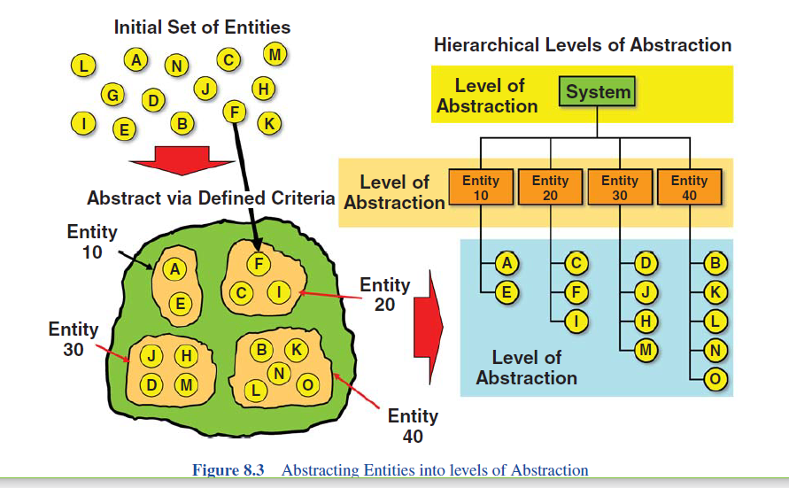
Abstraction

Slide 8
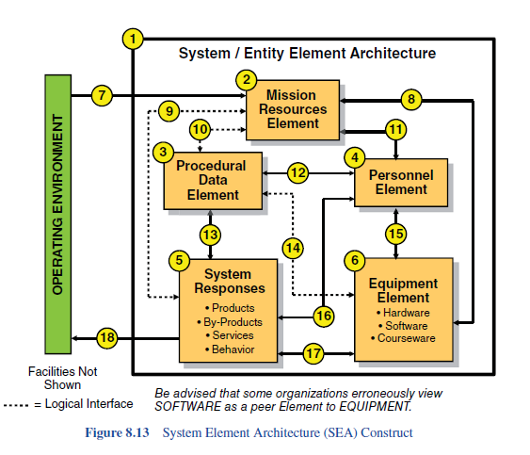
System Element Architecture

Slide 9
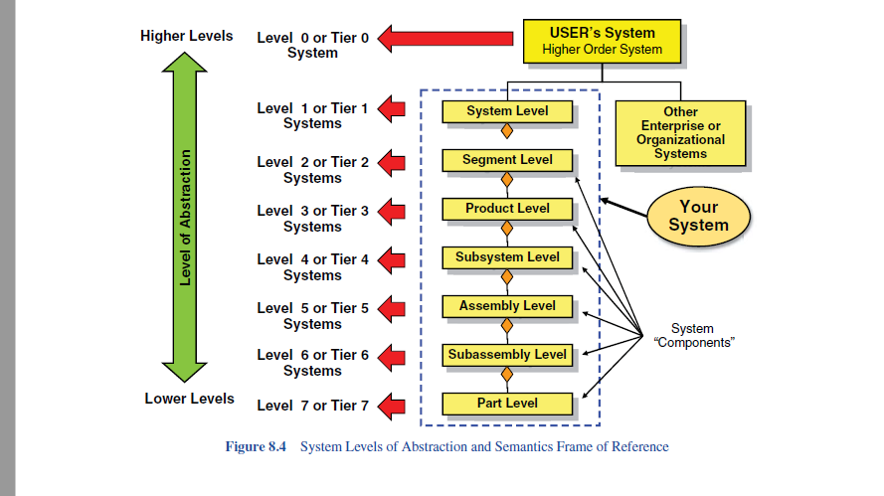
System level abstraction

Slide 10
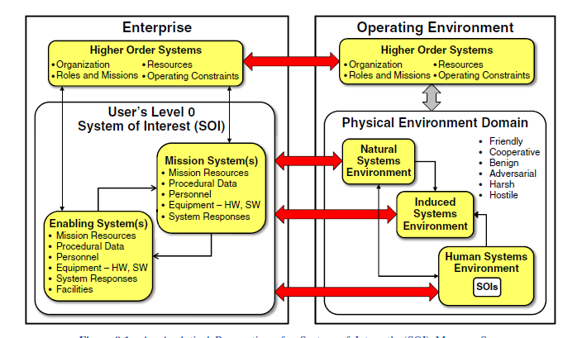
System/Entity Architecture

Slide 11
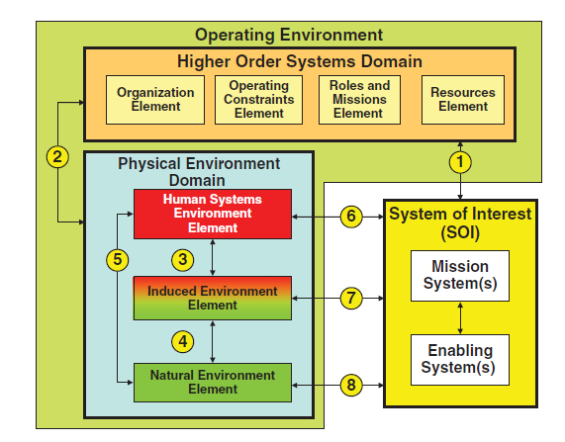
SOI’s Operating Environment (OE) Architecture

Slide 12
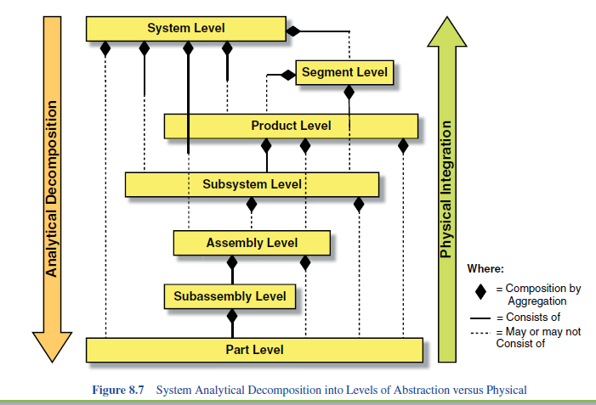
Levels of abstraction

Slide 13
functional analysis and decomposition - list of tools and diagrams
IDEF0 diagram
Functional flow block diagram (FFBD)
N^2 diagrams - diagram represents the logical data flow for a system or system segment.
Timeline analysis
Tree diagrams
SysML (such as activity diagrams, sequence diagrams)

Slide 14
Example of functional specifications
Business Rules
Transaction corrections, adjustments and cancellations
Administrative functions
Authentication
Authorization levels
Audit Tracking
External Interfaces
Certification Requirements
Reporting Requirements
Historical Data
Legal or Regulatory Requirements

Slide 15
non-functional requirements are
Performance – for example Response Time, Throughput, Utilization, Static Volumetric
Scalability
Capacity
Availability
Reliability
Recoverability
Maintainability
Serviceability
Security
Regulatory
Manageability
Environmental
Data Integrity
Usability
Interoperability

Slide 16
IDEF0 diagram
Constraints
& Triggers
Function
(described as noun-verb pair)
Inputs
Function
(Description as
noun-verb pair)
Clean Dirty Kitchen Items
Output
Resources

Slide 17
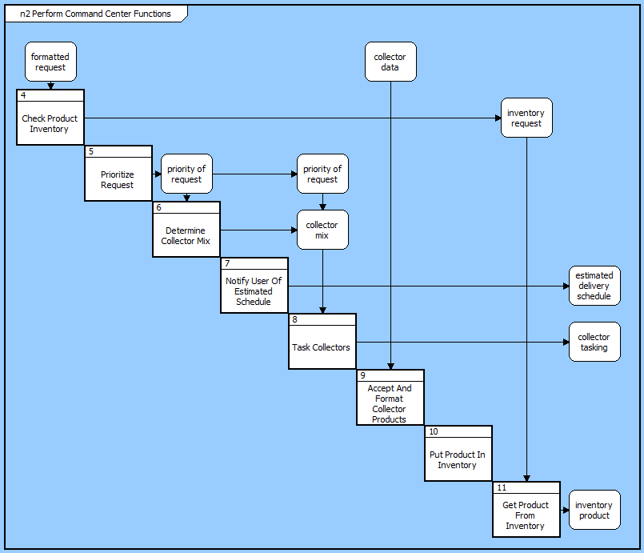
N^2 diagram

Slide 18
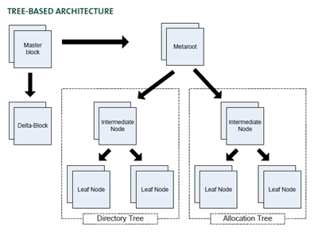
Tree diagrams

Slide 19
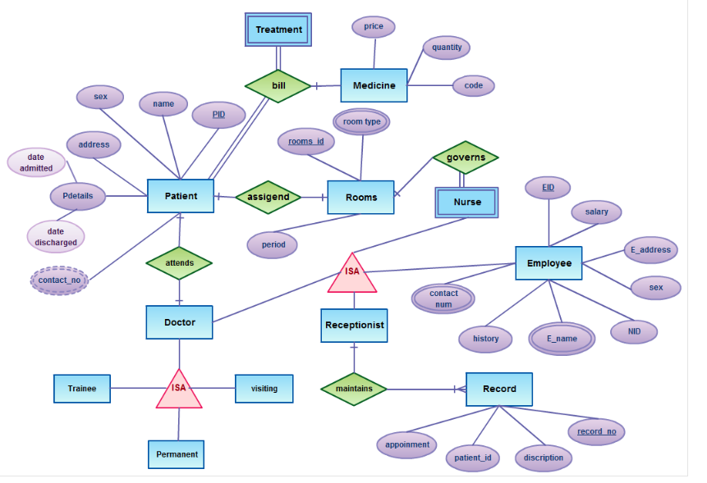
Entity Relationships

Slide 20
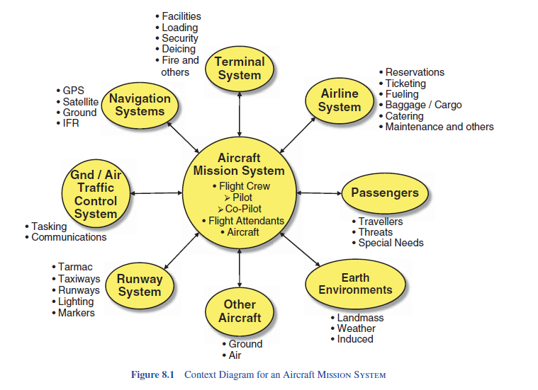
context diagram
Source: Systems Engineering by Wasson

Slide 21
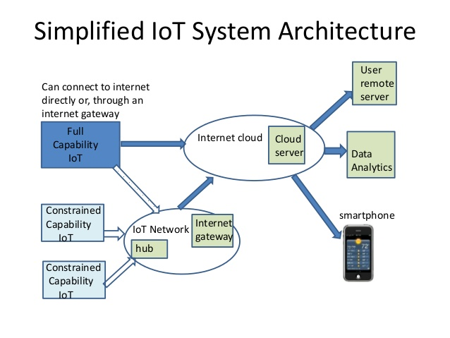

Slide 22
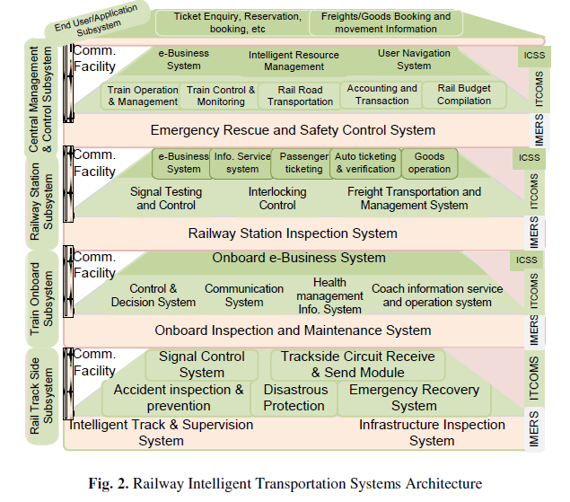
Kumar N., Kumari N. (2012) Conceptual Architectural Design of Indian Railway Intelligent Transportation Systems. In: Vinel A., Mehmood R., Berbineau M., Garcia C.R., Huang CM., Chilamkurti N. (eds) Communication Technologies for Vehicles. Nets4Cars/Nets4Trains 2012. Lecture Notes in Computer Science, vol 7266. Springer, Berlin, Heidelberg

Slide 23
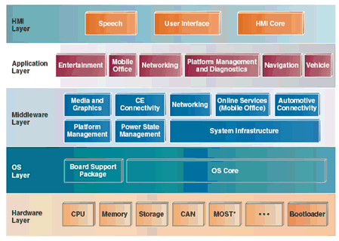
An Architecture for In-Vehicle Infotainment Systems
Source: Intel team article in Dr Dobbs

Slide 24
functional, physical, and system architectures
1. Example or case study: Mobile phone based voting systems – for national/state elections.
Problem statement: ??
2. Functional Architecture: Identify and structure the allocated functional and performance requirements.
What are functional requirements?
Of a OS?
Of a school bag?

Slide 25
Challenge for System Responses
how do you measure an external system response such as a human that has no intention of producing a response?
The reality is: Human Systems may or may not produce an output to avoid detection, survival, or it might be internal-thought driven and so forth.

